Slide 1
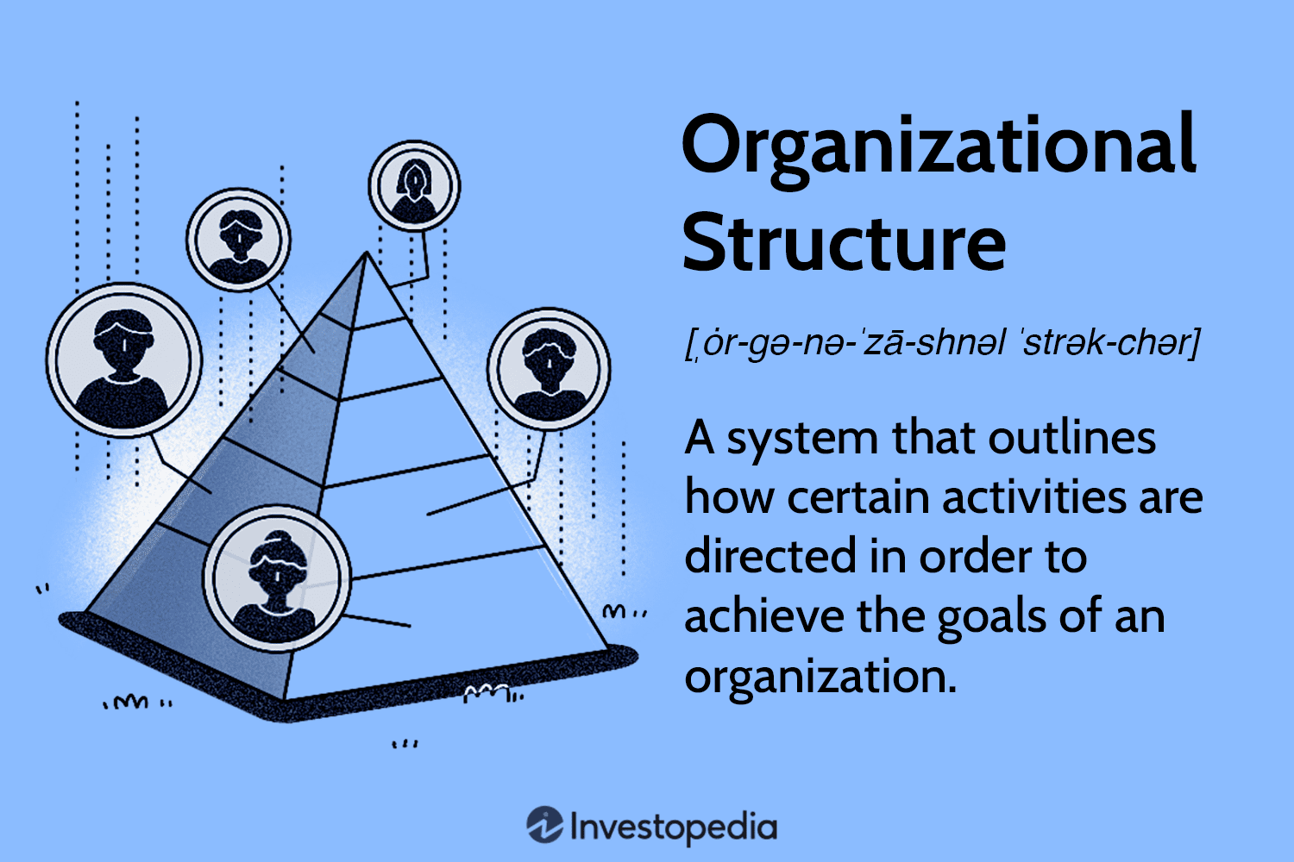
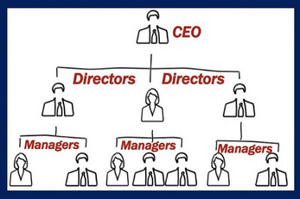
Most project structures are functional, ie they outline how project activities are organised and allocated to people holding delegated responsibilities that contribute to the delivery of the project’s product or service or enterprise results.
The structural design of an organisation structure (aka org chart) is influenced by the organisation’s strategies.
The orientation of design patterns can be functional, geographical, cost centred, product/service categorised, etc
Example of 3 Possible Functional Project Structures
Project Sponsor
Portfolio Manager
Project structures, are NOT the same as organisation structures, however, they can be designed using the same org chart design methods:
Projects under portfolios, deliver discrete products or services or targeted enterprise results that important strategic tools or achievements.
Projects under programs, deliver discrete products or services or targeted enterprise results that are components of strategic tools or achievements.
Projects, independent on their own, deliver discrete products or services or targeted enterprise results that are discrete strategic tools or achievements.
Program Manager
Program Manager
Project Manager
Project Manager
Project Manager
PMO
PMO
PMO
User Rep
User Rep
User Rep
SDLC Function Management Delegated Persons
SDLC Function Management Delegated Persons
SDLC Function Management Delegated Persons

Slide 2
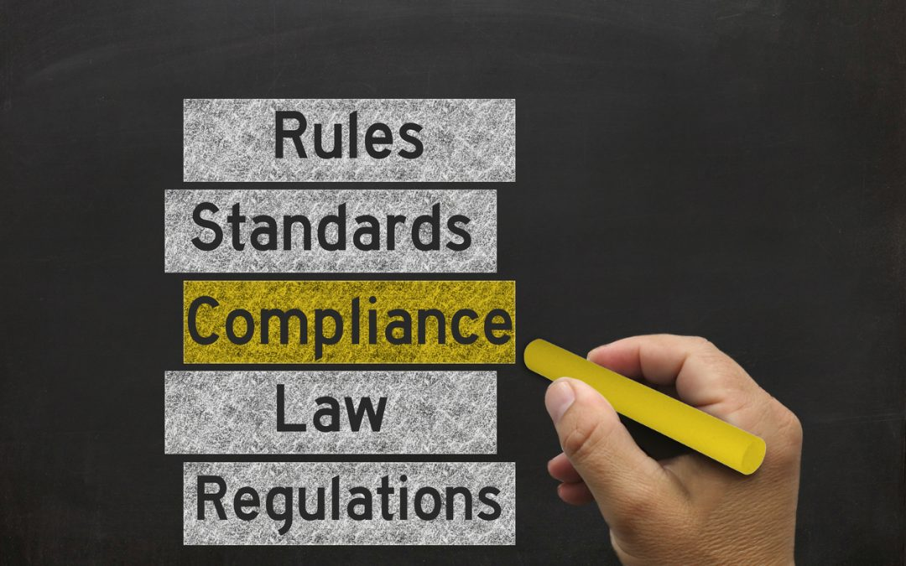
Governance Frameworks
Ensures ethical and ESG behaviours & practices prevail in all levels of strategy planning to execution (and daily routine operational work)
Compliance Frameworks of Rules, Standards, Laws & Regulations
Corporate Governance Framework
Corporate Strategies
Eg ANZ Corporate Governance Framework
Business Unit Governance Frameworks
Business Unit Strategies
Eg IT Division Governance Frameworks
Functional Governance Frameworks
Functional Strategies
Eg Project Governance Frameworks
Portfolio Governance Frameworks
Program Governance Frameworks
Q for Assignment: What project rules, standards, legislation policies, procedures, etc are needed in project work, to ensure the right ethical & ESG behaviours & practices prevail in all project work, including PM?
Project Governance Frameworks

Slide 3
Q for Assignment: What project rules, standards, legislation policies, procedures, etc are needed in project work, to ensure the right ethical & ESG behaviours & practices prevail in all project work, including PM?
Project Governance Framework
What info is inside?
Prompt | Conduct (Behaviour) | Practice
What project rules are recommended? | ? | ?
What project standards are required? | ? | ?
What legislation associated polices are required? | ? | ?
What guiding procedures & templates are required? | ? | ?
Notes:
Project rules – eg design methods, coding structures
Project standards – any SDLC standards eg IAP2, BABoK, V-testing model, ISO quality standards, OMG architecture models, etc
Legislated policies – usually corporate polices linked to privacy and security Acts, cybersecurity laws, critical infrastructure security Act, NFT Exchange regulations, etc
Guiding procedures – any internal project procedures eg documentation management, knowledge management, contractors management, testing procedures, project procurement procedures, etc; templates are how these procedures’ documented outputs should be structured and formatted.

